Slide 1
FLEXBOX LAYOUT
FILLS OR SHRINKS – Thus the word “FLEX”

Slide 2
Introduction
The Flexbox Layout aims at providing a more efficient way to align and distribute space among items in a container, even when their size is unknown and/or dynamic (thus the word "flex").
Flex layout gives the container the ability to alter its items' width/height to fill the available space.
Mostly to accommodate to all kind of display devices and screen sizes.
A flex container expands items to fill available free space or shrinks them to prevent overflow.

Slide 3
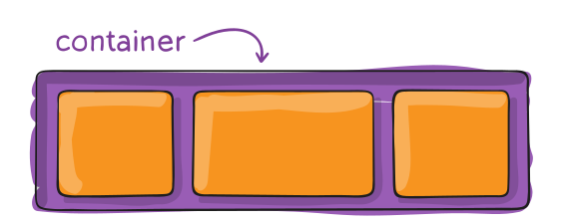
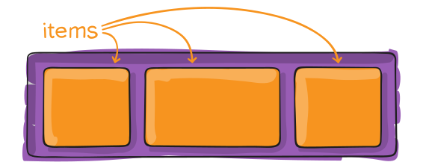
Basic Terminologies
Flex container - Properties for Parent
Flex items – Properties for Children

Slide 4
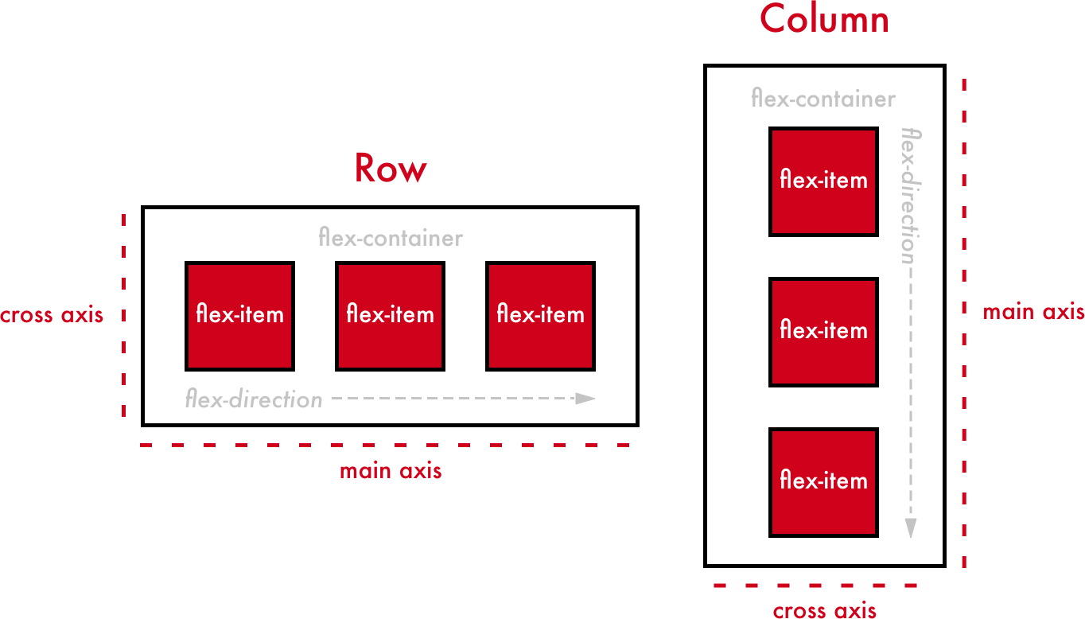
Flex – Axis / Directions
Flex layout is based on “flex axis” and "flex-flow directions“.

Slide 5
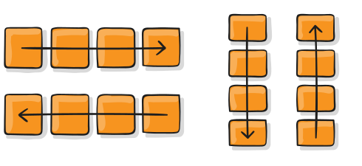
Flex - Direction
Direction of flex items in flex container.
.container {
flex-direction: row | row-reverse | column |column-reverse;
}

Slide 6
Flex - Axis
Flex axis – two types :
Main axis
Cross axis
Main axis –
Primary axis – flex items direction
Main-start & Main-end – start and end of main axis
Cross axis –
Axis perpendicular to main axis
Cross-start & Cross-end – start and end of cross axis

Slide 7
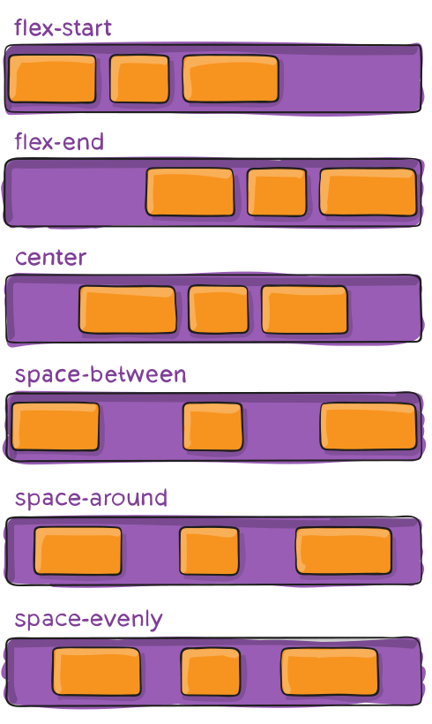
Justify-content
Alignment along the main axis.
justify-content:
flex-start | flex-end | center | space-between | space-around | space-evenly;

Slide 8
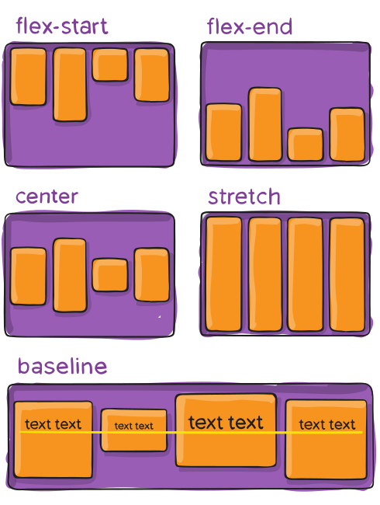
Align-items
Alignment along cross axis
align-items:
stretch | flex-start | flex-end | center | baseline

Slide 9
Align-content / Align-self
Align container - Aligns flex container's lines.
Align self - Works like align-items, but applies only to single item.
Reference - https://cssreference.io/flexbox/

Slide 10
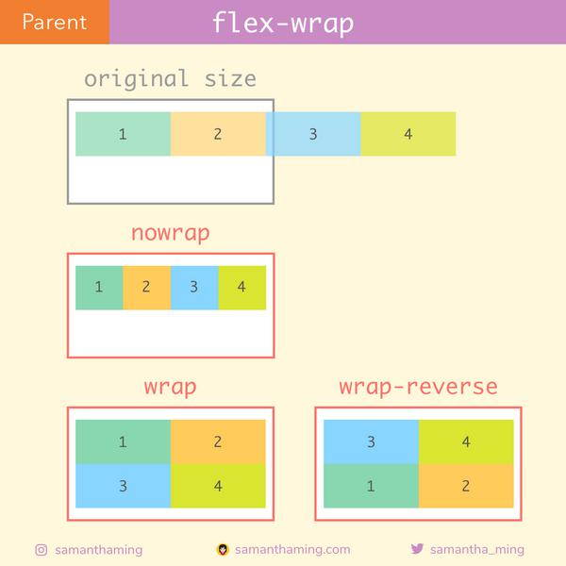
Flex - wrap
Wrap the flex items within the flex container.
Properties –
nowrap
wrap
wrap-reverse

Slide 11
Any Queries ?
Play around - https://flexboxfroggy.com/

Slide 12
Thank you - Shobika Babu

